Slide 1
Crisis and Emergency Risk Communication
Keith F Hansen, MBA
Assistant Dean, College of Public Health
Executive Director, Assn of Healthcare Emergency Preparedness Professionals
Co-Director of the Center for Preparedness Education

Slide 2
The Basics
Be First: Crises are time-sensitive. For members of the public, the first source of information often becomes the preferred source.
Be Right: Accuracy establishes credibility. Information can include what is known, what is not known, and what is being done to fill in the gaps.
Be Credible: Honesty and truthfulness should not be compromised during crises.
Express Empathy: Addressing what people are feeling, and the challenges they face, builds trust and rapport.
Promote Action: Giving people meaningful things to do calms anxiety, helps restore order, and promotes a restored sense of control.
Show Respect: Respectful communication promotes cooperation and rapport.

Slide 3
Common Communication Failures
Mixed messages from multiple experts
Boil water orders
Information released late
Post-tornado volunteer staging area
Paternalistic attitudes
“Don’t worry”
Not countering rumors and myths in real time
Sharks on the highway
Public power struggles and confusion
Two ‘bosses’

Slide 4
Fake News?
Notes:
Emphasize the importance of being right and credible over being first. It is important to share what you know and what you do not know at the time. Loop back to candlestick and railroad activity
Example: Fox news during Hurricane Harvey.

Slide 5
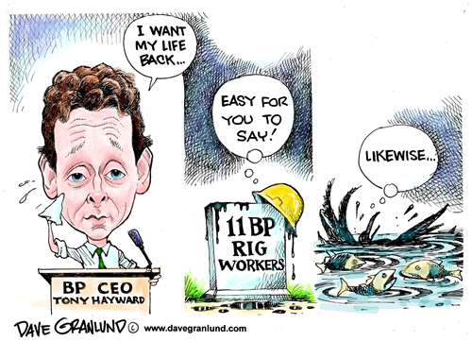
BP Case Study
Notes:
https://www.youtube.com/watch?v=MTdKa9eWNFw
TONY HAYWARD In the first stages of the crisis, the company went to the press saying that the spill was only to the tune of around 1,000 barrels a day. It turned out the stat was five times the amount, but even then, company spokespeople downplayed the figure.
- Knowing the facts and taking time to confirm them is imperative if you’re going to face the press to speak about your crisis. It ensures credibility from the outset. (RIGHT AND CREDIBLE)
- The BP chief had remarked “I want my life back,” to several news organizations, including Reuters, in recent days. (LACK OF EMPATHY AND RESPECT)
-“I made a hurtful and thoughtless comment,” Hayward said in a statement. “I apologize, especially to the families of the 11 men who lost their lives in this tragic accident. Those words don’t represent how I feel about this tragedy.”

Slide 6
Four Ways People Process Information during a Crisis
1. We Simplify Messages
2. We hold on to current beliefs
3. We look for additional information and opinions
4. We believe the first Message

Slide 7
We simplify messages
Under intense stress and possible information overload, we tend to miss the nuances of health and safety messages by doing the following:
Not fully hearing information because of our inability to juggle multiple facts during a crisis
Not remembering as much of the information as we normally could
Misinterpreting confusing action messages
To cope, many of us may not attempt a logical and reasoned approach to decision making. Instead, we may rely on habits and long-held practices. We might follow bad examples set by others.

Slide 8
We hold on to current beliefs
Crisis communication sometimes requires asking people to do something that seems counterintuitive, such as evacuating even when the weather looks calm.
Changing our beliefs during a crisis or emergency may be difficult. Beliefs are often held very strongly and not easily altered. We tend not to seek evidence that contradicts beliefs we already hold.
We also tend to exploit any conflicting or unclear messages about a subject by interpreting it as consistent with existing beliefs. Faced with new risks in an emergency, we may have to rely on experts with whom we have little or no experience.
Notes:
For example, we might tell ourselves, “I believe that my house is a safe place.” Before an impending hurricane, however, experts may recommend that we evacuate from an insecure location and take shelter in a building that is stronger and safer. Although the action advised is actually for us to evacuate our house to seek a safer shelter, we can easily misinterpret the recommendation to match our current beliefs. We might say, “My home is strong and safe. I’ve always been secure in my home. When we left last time, the hurricane went north of us anyway. I’ll just stay here.”
Often, reputable experts disagree regarding the level of threat, risks, and appropriate advice. The tendency of experts to offer opposing views leaves many of us with increased uncertainty and fear. We may be more likely to take advice from a trusted source with which we are familiar, even if this source does not have emergency related expertise and provides inaccurate information.

Slide 9
We look for additional information and opinions
We remember what we see and tend to believe what we’ve experienced. During crises, we want messages confirmed before taking action. You may find that you or other individuals are likely to do the following:
Change television channels to see if the same warning is being repeated elsewhere
Try to call friends and family to see if others have heard the same messages
Turn to a known and credible local leader for advice
Check multiple social media channels to see what our contacts are saying.
In cases where evacuation is recommended, we tend to watch to see if our neighbors are evacuating before we make our decision. This confirmation first—before we take action—is very common in a crisis.

Slide 10
We believe the first message
During a crisis, the speed of a information can be an important factor in reducing harm. In the absence of information, we may begin to speculate and fill in the blanks – this often results in rumors. The first message to reach us may be the accepted message, even though more accurate information may follow. When new, perhaps more complete information becomes available, we compare it to the first messages we heard.
Because of the way we process information while under stress, when communicating with someone facing a crisis or disaster, messages should be simple, credible, and consistent. Speed is also very important when communicating in an emergency.
An effective message must do the following:
Be repeated
Come from multiple credible sources
Be specific to the emergency being experienced
Offer a positive course of action that can be executed.

Slide 11
Message Mapping

Slide 12
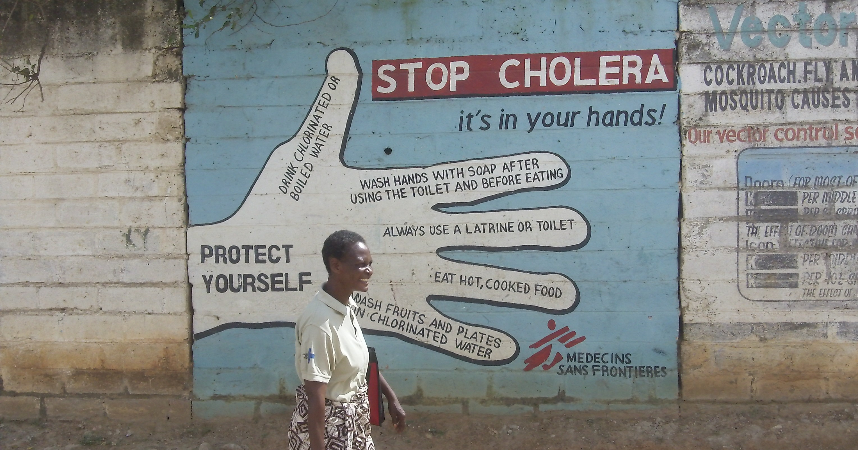
Situation: Cholera Outbreak

Slide 13
Step 1
Identify Stakeholders
Victims
Victim families
Directly affected individuals
Emergency response personnel
Hospital personnel
Government
The media
Private companies
Groups with special needs
Etc.
Example
Audience: General Public

Slide 14
Step 2
Identify a complete list of specific concerns for each group
Overarching questions (For example: What is the most important thing the audience should know?)
Information questions (For example: What is the budget allocated for your response?)
Challenging questions (For example: Why should we trust you?)
Example
Audience: General Public
Questions:
What is cholera?
How is it spread?
What are the signs of cholera?
How do you protect yourself against cholera?
Notes:
Research indicates that more than 95% of the concerns that will be raised by any stakeholder in a crisis situation can be predicted in advance using these techniques

Slide 15
Step 3
Analyze the list of specific concerns to identify common sets of underlying concerns
Example
Audience:
General Public
Questions:
What is cholera?
How is it spread?
What are the signs of cholera?
How do you protect yourself against cholera?
Example
Audience:
Local and National Press
Questions:
What is cholera?
How is it spread?
What are the signs of cholera?
What do you do if you suspect someone has cholera?

Slide 16
Step 4
Develop key messages in response to each question, concern, or perception
Key messages should be based on what the target audience needs to know and wants to know most.
Mental noise theory = when people are upset, the ability to process information is reduced by more than 80%.
Example
Key Message:
Cholera is a severe diarrheal disease

Slide 17
Principles to Guide Key Message Development
Conciseness:
Limit the number of key messages (ideally 3 key messages)
Brevity:
Keep each key message less than 3 seconds
Clarity:
Clearly understandable for the general public (reading level of a ~13 year old)

Slide 18
Step 5
Example
Key Message:
Cholera is a severe diarrheal disease
Supporting Facts:
Cholera is caused by bacteria found in feces
Cholera causes mild to severe watery diarrhea that looks like rice water
In severe cases, diarrhea is accompanied by vomiting and weakness
Develop supporting facts and proofs for each key message

Slide 19
Step 6
Systematic message testing using standardized message testing procedures
Example
Peer organizations
Surrogate target audience

Slide 20
Step 7
Plan for delivery of prepared message maps through:
A trained spokesperson
Appropriate communication channels
Trusted individuals or organizations

Slide 21
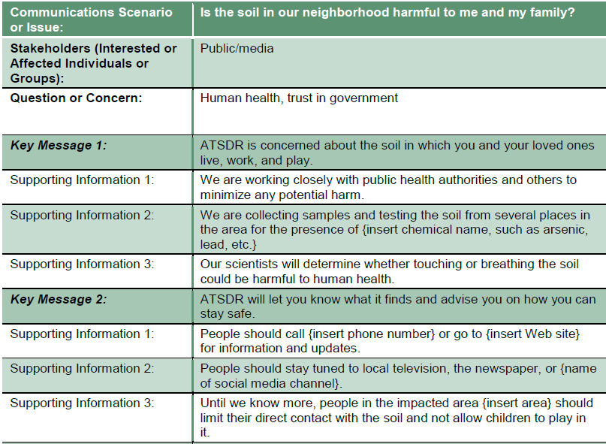
Notes:
From the CDC, Agency for Toxic Substances and Disease Registry.

